Slide 1
CREDIT CARD FRAUD DETECTION

Slide 2
About the Project
Credit Card Fraud Detection system is used by banks to protect their customers from fraud.
The project aims at predicting whether any specific credit card transaction is authentic or not.
Identifying any transaction as fraud is a tedious task and at times it leads to delay in the purchase of the required items by the card holder.

Slide 3
Dataset
Source:
https://www.kaggle.com/kartik2112/fraud-detection
The given dataset consists of one csv file namely fraudTrain which will be used for both training and testing purposes.
The dataset used consists of 23 attributes with the target variable as is_fraud.

Slide 4
DESIGN AND IMPLEMENTATION
Data Preprocessing
This method is used for converting the given dataset into useful format.
This method comprises of 3 steps namely Data Reduction,Data Cleaning and Data Transformation
Data cleaning is mainly used for imputing the missing values; but we don’t have any missing value for the given dataset so this step is not considered.
The dataset present is highly imbalanced.Most of the transactions are not fraud.If we continue to use this data as our base for the predictive models and analysis then our algorithm overfits. To get rid of this problem we balance the data by using sampling. Sampling is a part of data reduction which is performed on the subset of the entire dataset.

Slide 5
DESIGN AND IMPLEMENTATION
2. Exploratory Data Analysis(EDA)
This method is used for analyzing and exploring the dataset..
EDA comprises of several data visualization methods for outlining the major characteristics present in the given data.
In the given problem we have primarily used bar plots for predicting the target variable is_fraud based on different predictors such as gender, weekday and categories.

Slide 6
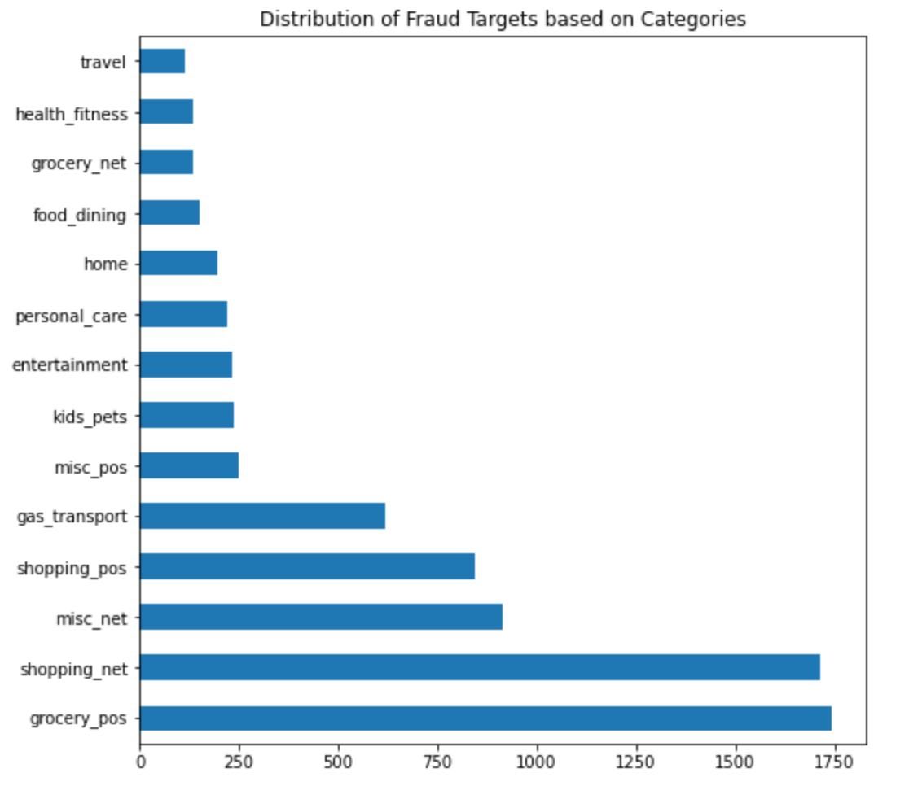
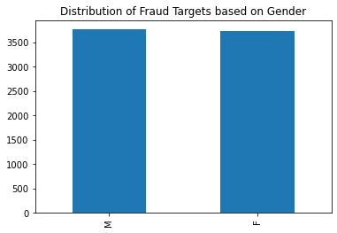
DESIGN AND IMPLEMENTATION
2. Exploratory Data Analysis(EDA)
We can see that there is no significant difference in the frauds based on gender but based on categories we can see that frauds are more prevalent in online shopping and grocery shopping

Slide 7
DESIGN AND IMPLEMENTATION
3. Feature Selection
This method reduces the number of predictors(or input variables) by selecting the most important features while discarding the least important ones.
This step improves the overall performance of the model.
In this problem we use correlation matrix for feature selection. Features having higher correlation between them are linearly dependent and are considered for model selection whereas lower correlation value between two variables suggest that the variables are independent of each other.

Slide 8
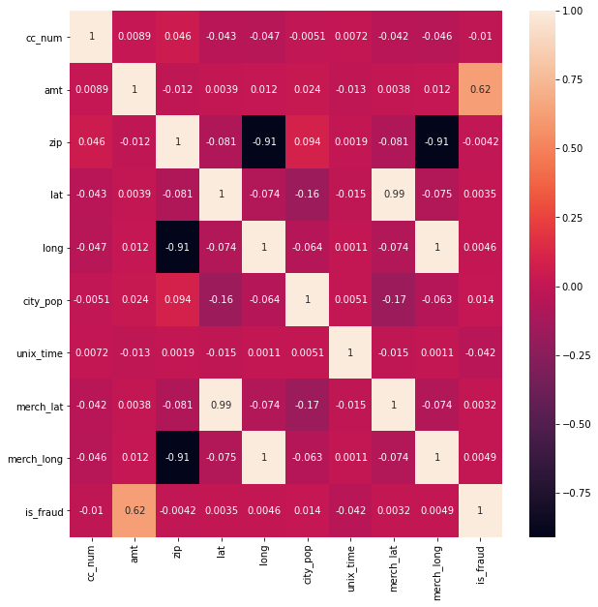
DESIGN AND IMPLEMENTATION
3. Feature Selection

Slide 9
DESIGN AND IMPLEMENTATION
4. Modelling
This method involves training and testing on the given data.
For training and testing we have splitted the fraudTrain dataset into 70% for training and 30% for testing.
The classifier used for training are Random Forest and XGBoost Classifier.
The performance is evaluated using metrics like confusion matrix and accuracy.
The loss function we have used is Mean Squared error.

Slide 10
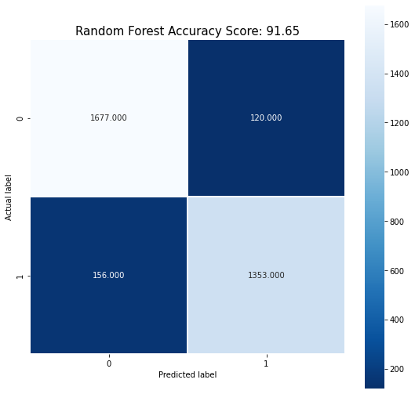

DESIGN AND IMPLEMENTATION
4. Modelling (Confusion Matrices of the models)

Slide 11
EVALUATION RESULTS
We have observed that Random Forest after sampling has an accuracy score of 91.5% while the loss function is quite small for the given model.
Smaller loss function indicates that the errors made in the process of fitting the model is very less further stating that the predictive model used is highly efficient.
The reason for good performance is that Random Forest is very suitable for dealing with high dimensional noisy data(in other words highly imbalance data).
The other classifier used is XGBoost with an overall accuracy score of 91.77%.
XGBoost performs the best for the reason being that it tunes the parameters by itself and works in a parallelized fashion distributed among clusters. Therefore, the balanced the data in the clusters the better it performs.

Slide 12
Libraries Used
Numpy: used for working with arrays. It also has functions for working in domain of linear algebra, matrices, etc.
Pandas: Data analysis and manipulation. Key data structure is DataFrame. Built upon NumPy.
Matplotlib: plotting library. Draw inline plots for quick data analysis (basic plotting)
datetime: used for manipulating dates and times
Seaborn: data visualization library. Drawing attractive and informative statistical graphics
StandardScaler: standardizes a feature by subtracting the mean and then scaling to unit variance. Unit variance means dividing all the values by the standard deviation.
train_test_split
mean_squared_error
make_pipeline
Sklearn: machine learning library

Slide 13
CHALLENGES FACED
Unavailability of public data: The data required for fraud detection system is highly sensitive in nature ; therefore many times there is lack of proper datasets to evaluate the existing predictive models for the same.
Imbalanced data: The actual number of fraudulent cases is way less than the non-fraudulent one. We can even observe this for the dataset used in the given problem.Thereby models do not work as efficiently as they should on these types of data.

Slide 14
FUTURE SCOPE
Using more unsupervised algorithms and neural networks and deep learning for predicting authenticity of fraud accurately without raising any false alarms.
In our given problem we haven’t made any use of deep learning techniques so using it can be the next big thing after the machine learning models for understanding the patterns of the credit card user in a much better way which can further help us to detect the fraudulent cases with a greater efficiency.
Therefore in our future scope we recommend using deep learning models.

Slide 15
REFERENCES
https://datasciencecmu.wordpress.com/2014/04/18/the-future-of-fraud-detection-2/
https://www.ripublication.com/ijaer18/ijaerv13n24_18.pdf
https://www.ijcseonline.org/pub_paper/2-IJCSE-08130.pdf
https://www.questjournals.org/jrhss/papers/vol8-issue2/B08020411.pdf
https://www.ijsr.net/archive/v10i7/SR21712231418.pdf
http://www.iaeng.org/publication/IMECS2011/IMECS2011_pp442-447.pdf
https://www3.nd.edu/~dial/publications/dalpozzolo2015calibrating.pdf

